Slide 1
SMA 2230
LECTURE 1

Slide 2
AIM
At the end of this course the students should be able to handle problems involving probability distributions of a discrete or a continuous random variable

Slide 3
Introducing to Random variables
Definition
Types of random variable
Probability distribution
Probability mass function
Probability density function

Slide 4
Introducing to Random variables
The set of all possible outcomes of a statistical experiment is called a sample space. In most cases we are not interested in the elements constituting the sample space, but we may be interested only in some numerical representation of the events of the sample space.

Slide 5
Introducing to Random variables
Consider an experiment in which 100 randomly selected Kenyans are asked whether they agree or disagree with a draft constitution. If they answer YES or NO, then the sample space consists of elements.

Slide 6
Introducing to Random variables
Suppose we are only interested in the number of Kenyans who answer YES. Then a numerical value of 0, 1, 2... or 100 will be assigned to each element of the sample space. The number 0, 1, 2... Or 100 are random quantities, which are determined by the outcome of the random experiment of interviewing the Kenyans.

Slide 7
Introducing to Random variables
They may be regarded as the values assumed by a variable X defined on the sample. Since the possible values of X are random quantities, the variable X is referred to as a random Variable.
The study of random variables and their properties is central to the theory of probability and statistics.

Slide 8
Random Variables
Let S be a sample space representing the outcome of a Statistical experiment. Then we define a random variable as follows.
“A random variable X is a real valued function defined on S , that is X: S R”
The function X transforms the element of S into the real numbers. Thus if , then X(e) is the value of the random variable at the point e in S .

Slide 9
Random Variables
It is customary to use capital letters such as X, Y, Z and so on, to denote random variables and their corresponding lower case letters x, y, z and so on, to denote respective values of the random variables.

Slide 10
R.V’s-Example 1
Let a die be tossed once. Then the sample space is the set {1, 2, 3, 4, 5, and 6}. Let X denote the number of points on the face which shows up and Y denote twice the number of points on the face which shows up. Then X is a random variable with possible values 1, 2, 3, 4, 5, 6 and Y is a random variable with possible values 2, 4, 6, 8, 10 and 12.

Slide 11
R.V’s Example 2
Suppose that three students are selected at random from a class and each is asked whether he smokes-S or he does not smoke-N. Then the sample space of this random experiment is given by,
S = {SSS, SSN, SNS, NSS, SNN, NSN, NNS,
NNN}

Slide 12
R.V’s Example 2
Let X denote the number of smoker’s among the three students chosen, then;
X (SSS) = 3,
X (SSN) = X (SNS) = X (NSS) = 2
X (SNN) = X (NSN) = X (NNS) = 1, and
X (NNN) = 0
Thus X is a random variable which takes the values 0, 1, 2, or 3.

Slide 13
R.V’s - Example 3
Suppose that a real number is selected at random in the closed interval [0, 1]. Let X denote the number so chosen. Then X is a random variable with possible values given as,
?

Slide 14
Random Variables
Random variables are classified into two categories, depending on the nature of their ranges or images, these are:
Discrete random variables.
Continuous random variables

Slide 15
Discrete Random Variables
A random variable is said to be discrete if it assumes only finite or countable number of values on the real line, for example random variables described in examples 1 and 2.
A discrete random variable assumes each of its values with a certain probability. Consider the experiment in example 2 above, if we assume that all the outcomes are equally likely, then the random variable takes the values 0, 1, 2 or 3, with the following probabilities,

Slide 16
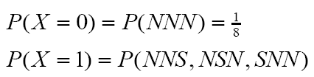



Discrete Random Variables

Slide 17

Discrete Random Variables
This information can be represented in a table as follows:

Slide 18
Probability Mass Function
The function represented by the above table indicates how the probability is distributed over the possible values of the random variable. Accordingly such a function is called a Probability Mass Function or just Probability Distribution of the random variable X

Slide 19














Probability Mass Function

Slide 20
Probability Mass Function
Example 4
A digit is selected at random from among the digits; 0 ,1,2,3,…,9 let X denote the digit so selected. What is the probability distribution of X?
Solution:
Selection is random, implying that each digit has an equal chance of selection. If X is any particular digit, then

Slide 21
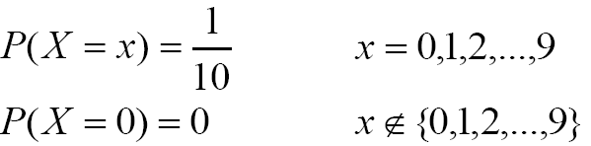

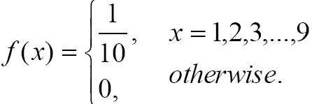
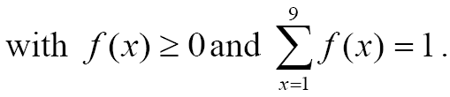
Probability Mass Function

Slide 22
Probability Mass Function
Example 5
Suppose that a dice is loaded in such a way that a face with an even number of points is twice as likely to show up as a face with an odd number of points. Let X denote the number of points on the face which shows up when the die is rolled once. Assuming that the even faces are equally likely and that the odd faces are also equally likely, determine the probability distribution of X .
Solution:
Let X be the probability of rolling an odd face, then X is a discrete random variable with possible values 1, 2, 3, 4, 5, 6.

Slide 23
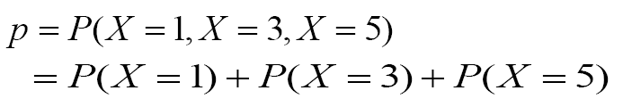


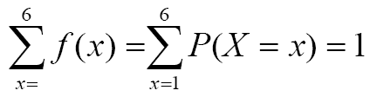



Probability Mass Function

Slide 24




Probability Mass Function

Slide 25

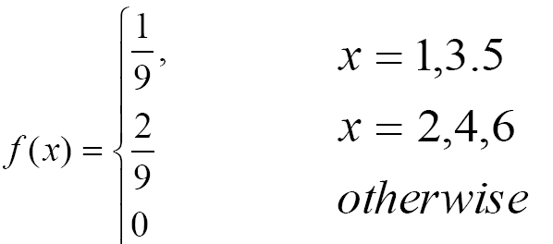
Probability Mass Function

Slide 26
Continuous Random Variables
A random variable is said to be continuous if it can assume values in an interval of the real line. Thus a continuous random variable assumes uncountable number of values.
Example 3 in the introduction section above, illustrates a continuous random variables which assumes values on the unit interval .

Slide 27
Continuous Random Variables
Example 6
Suppose an experiment involves observing the arrival of cars at a certain point along a highway, on a particular day. Let Y denote the times which lapses before the first arrival. Then Y is a continuous random variable which assumes values in the interval :

Slide 28
Probability Density Function
Definition 3:
Let X be a continuous random variable assuming values in R . A continuous real valued function is said to be a probability density function (p.d.f) or simply a probability distribution, of the random variable X if it satisfies,

Slide 29
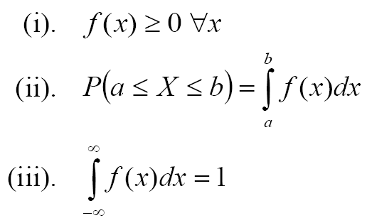
Probability Density Function

Slide 30

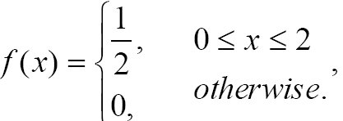

Probability Density Function

Slide 31


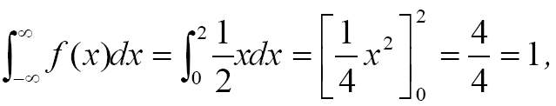


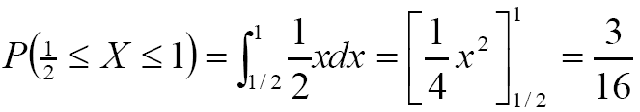
Probability Density Function

Slide 32



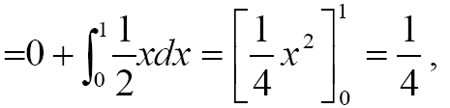
Probability Density Function

Slide 33

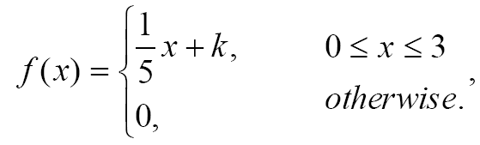

Probability Density Function

Slide 34

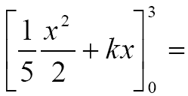
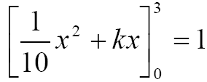
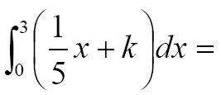
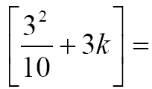
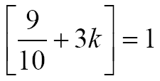

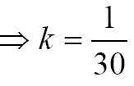
Probability Density Function

Slide 35

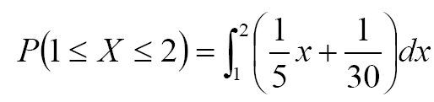
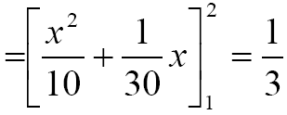
Probability Density Function

Slide 36

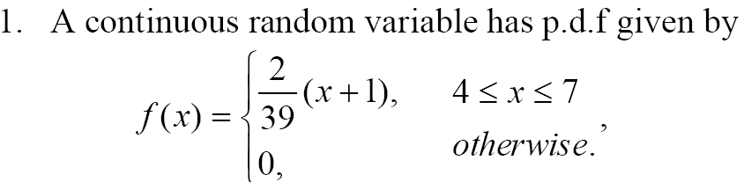
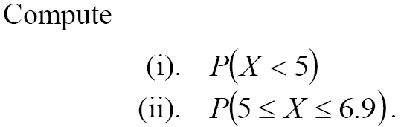
Probability Density Function

Slide 37

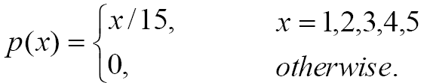
Probability Density Function

Slide 38

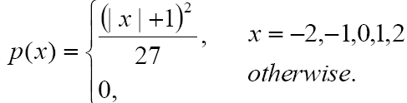
Probability Density Function

Slide 39
12:01:08 PM
END

